Slide 1

Study of Underground Hacker Forums
INSE 6610 - Cybercrime Investigations (Group No: 6)
Harmanjeet Singh
Amanpreet
Muskan
Benjamin K. Kolako Jnr
Kanwar Singh
Amisha Saxena
Jyotirmay Sharma
Tweneboa Kodua
Rishabh Jhamb
Kushagra Chakravarty
Frederick O. Agyemang
Seth Ekow Abaidoo

Slide 2
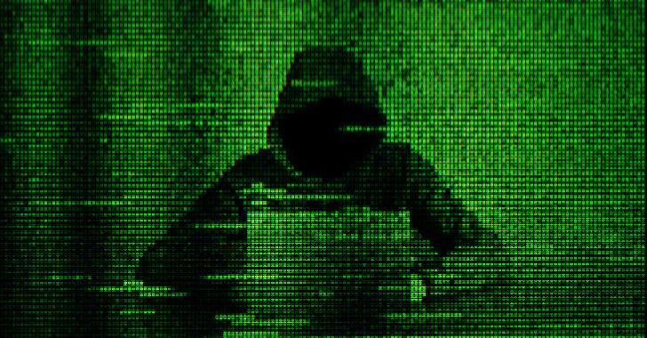
INTRODUCTION
Technological advancements have opened new
frontiers for communication, commerce, and knowledge sharing.
The dark side of the internet: Underground hacker forums.
Aims to shed light on the mysterious world of underground
hacker forums.
Forums serve as havens for illegal activities, offering a
Broad spectrum of nefarious services.
Below is the list of Forums that are included for this study:
The AbyssForum (http://qyvjopwdgjq52ehsx6paonv2ophy3p4ivfkul4svcaw6qxlzsaboyjid.onion/)
The Stock Insider (http://thestock6nonb74owd6utzh4vld3xsf2n2fwxpwywjgq7maj47mvwmid.onion/)
Fish&Pal (http://56dlutemceny6ncaxolpn6lety2cqfz5fd64nx4ohevj4a7ricixwzad.onion/)
Alpha Bay (Defunct Forum)
Hansa Market (Defunct Forum)
Notes:
Clandestine hubs for cybercriminals to exchange illicit goods, perpetrate cyberattacks, and discuss nefarious activities
away from law enforcement.
This Study delves into these hidden forums, uncovering their operations, activities, geographical distribution, and internet service they exploit, and the process of obtaining access to some of these exclusive online domains.

Slide 3
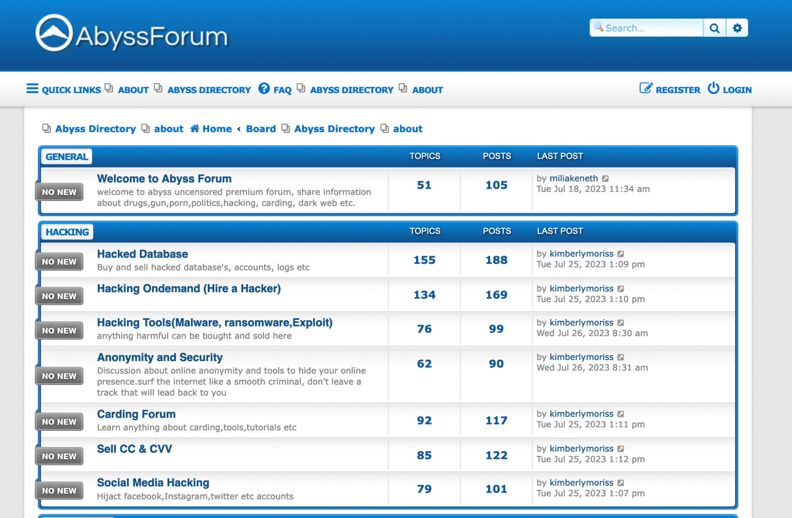
AbyssForum
Operates within the hidden corners of the dark web, accessible through anonymizing networks like Tor.
Emerged in the mid-2010s and has gained notoriety for facilitating a wide range of cybercriminal activities.

Slide 4
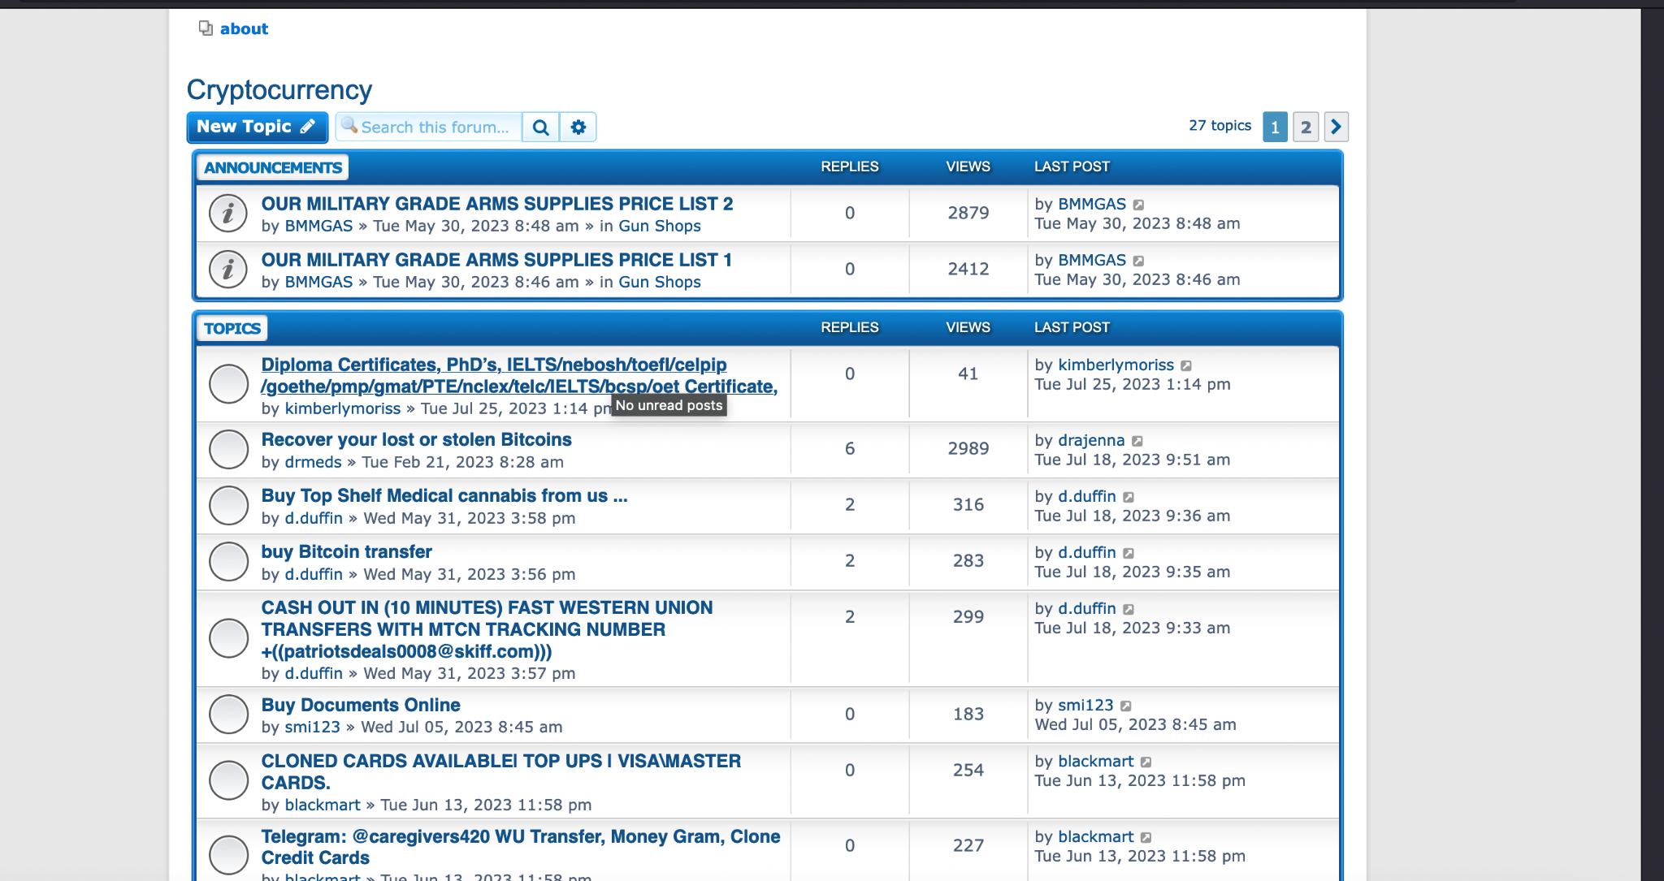

Slide 5
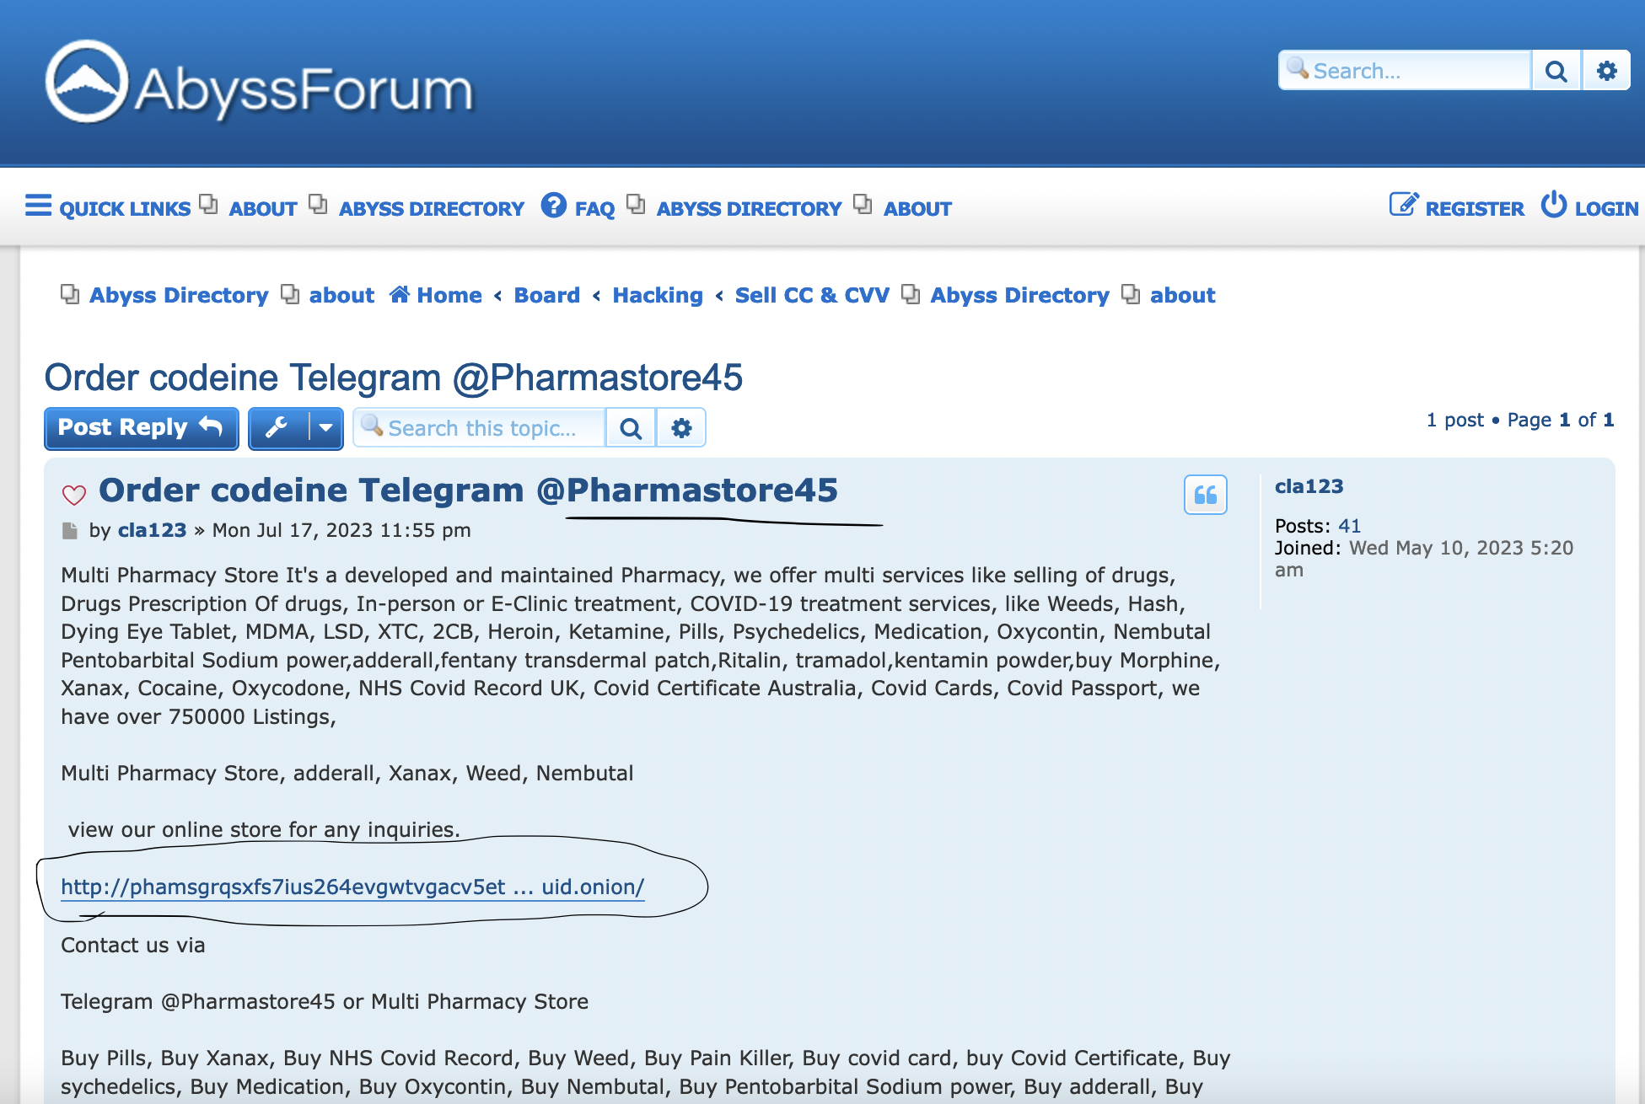
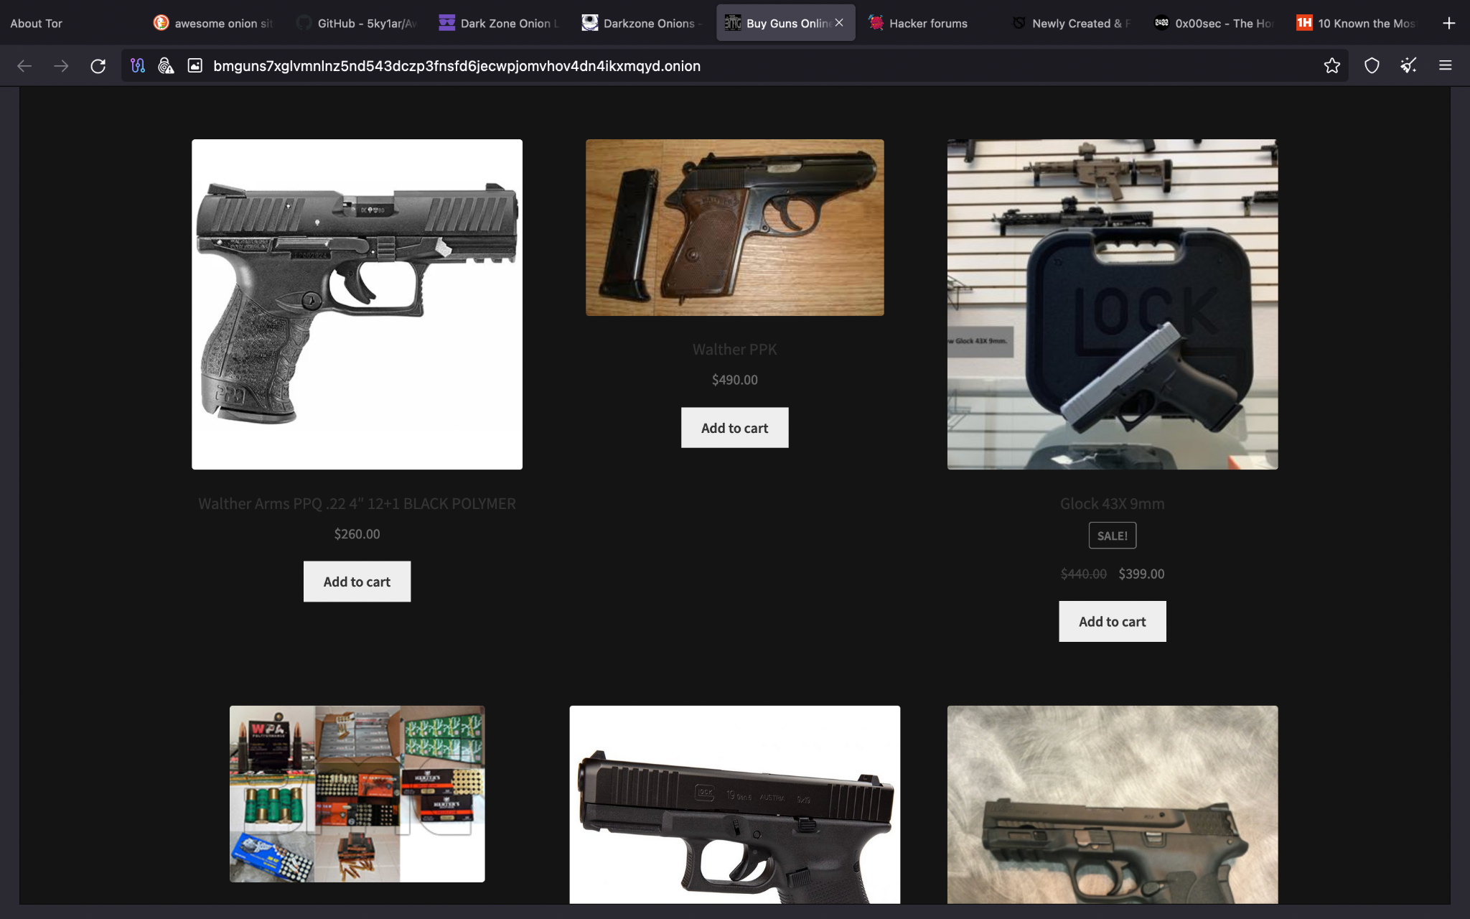
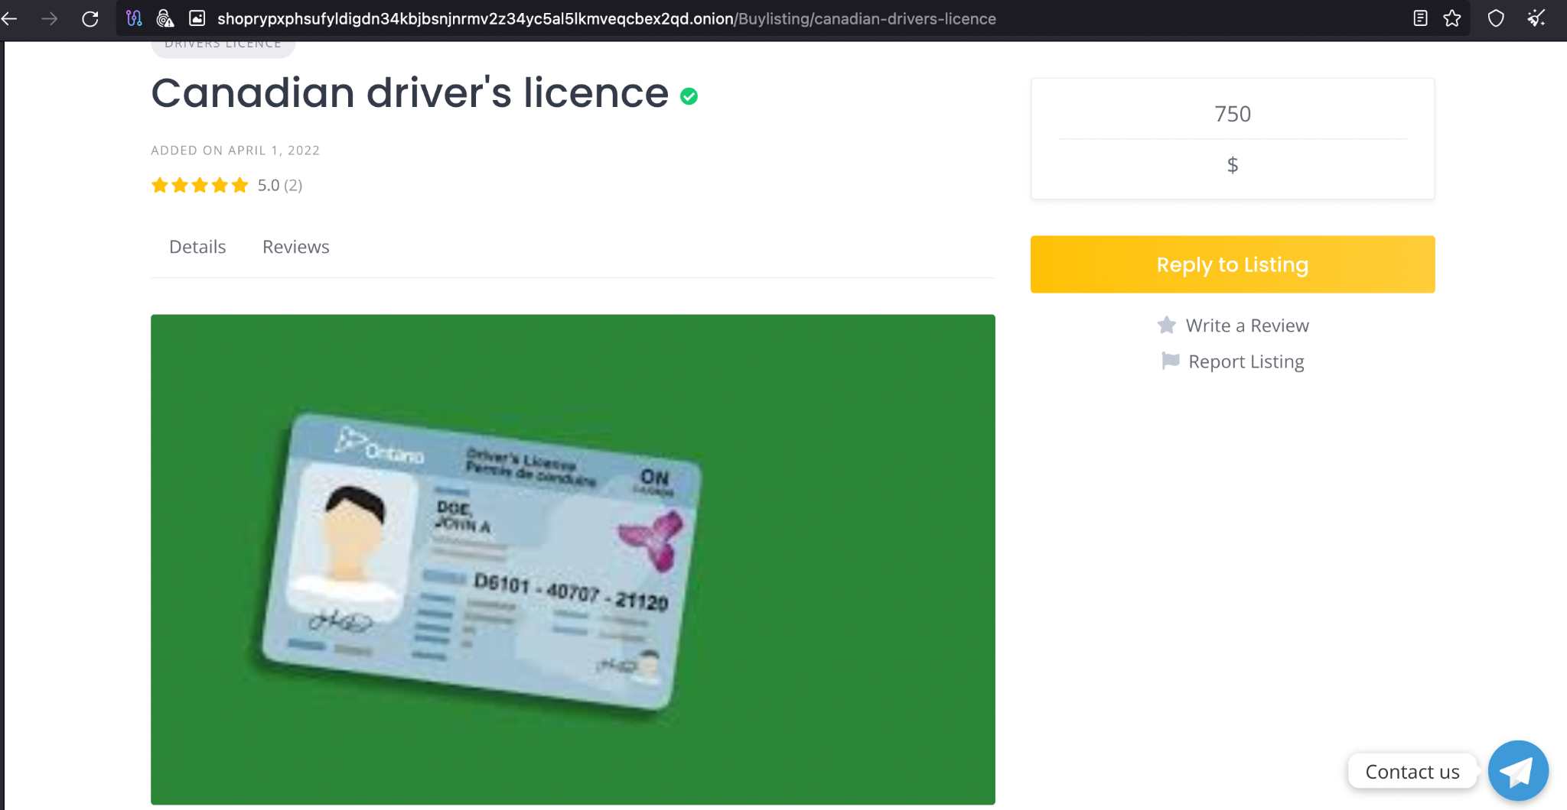

Slide 6
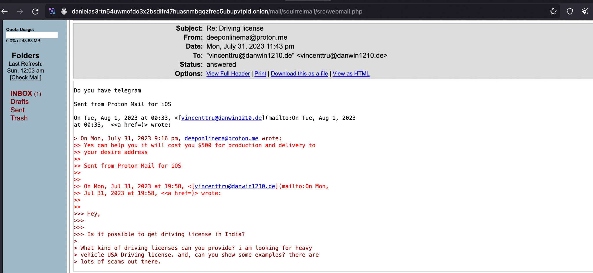
Access and Account Creation: Exploring Underground Hacker Forums
Utilized anonymous Tor mail service for secure communication.
Attempted engagement with sellers
on the forum.
Challenges in communication due
to cautious forum members.
Breakthrough achieved with response
from a seller.
Insights into seller's operations,
products, and reach obtained.
Contemplated potential use of
spear phishing for identification.
Ethical considerations and legal
boundaries adhered to throughout the
process.

Slide 7
Underground Forum: The Stock Insiders
Leveraging Insider Information for Trading and Stocks
The Stock Insiders is a secretive underground hacker forum.
Close-knit community focused on trading and stocks.
Members leverage insider information to make money anonymously.
Emphasis on strict anonymity and confidentiality.
"The first rule of Fight Club" principle - never talk about it outside the forum.

Slide 8
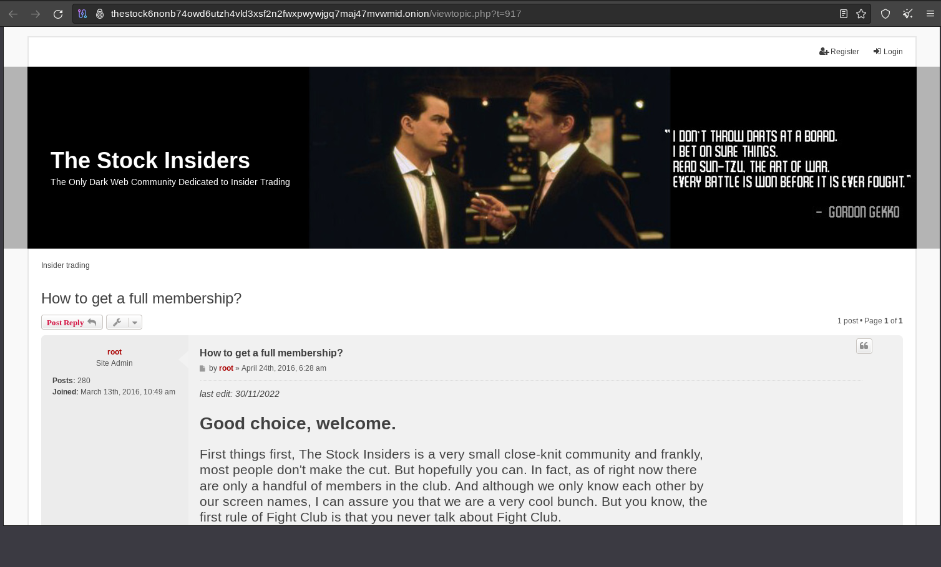

Slide 9
Application Process
Joining The Stock Insiders
The forum is highly exclusive; only true insiders are welcomed.
Registration: Unique nickname and email for complete anonymity.
Post Submission: Provide insider information about a publicly listed company with an active options market.
Timing: Post must be submitted at least one trading day before the information becomes public.
Verification and Questions: Private message with further questions to verify authenticity.
Confirmation: Successful applicants become "Insiders" and gain access to the forum.

Slide 10
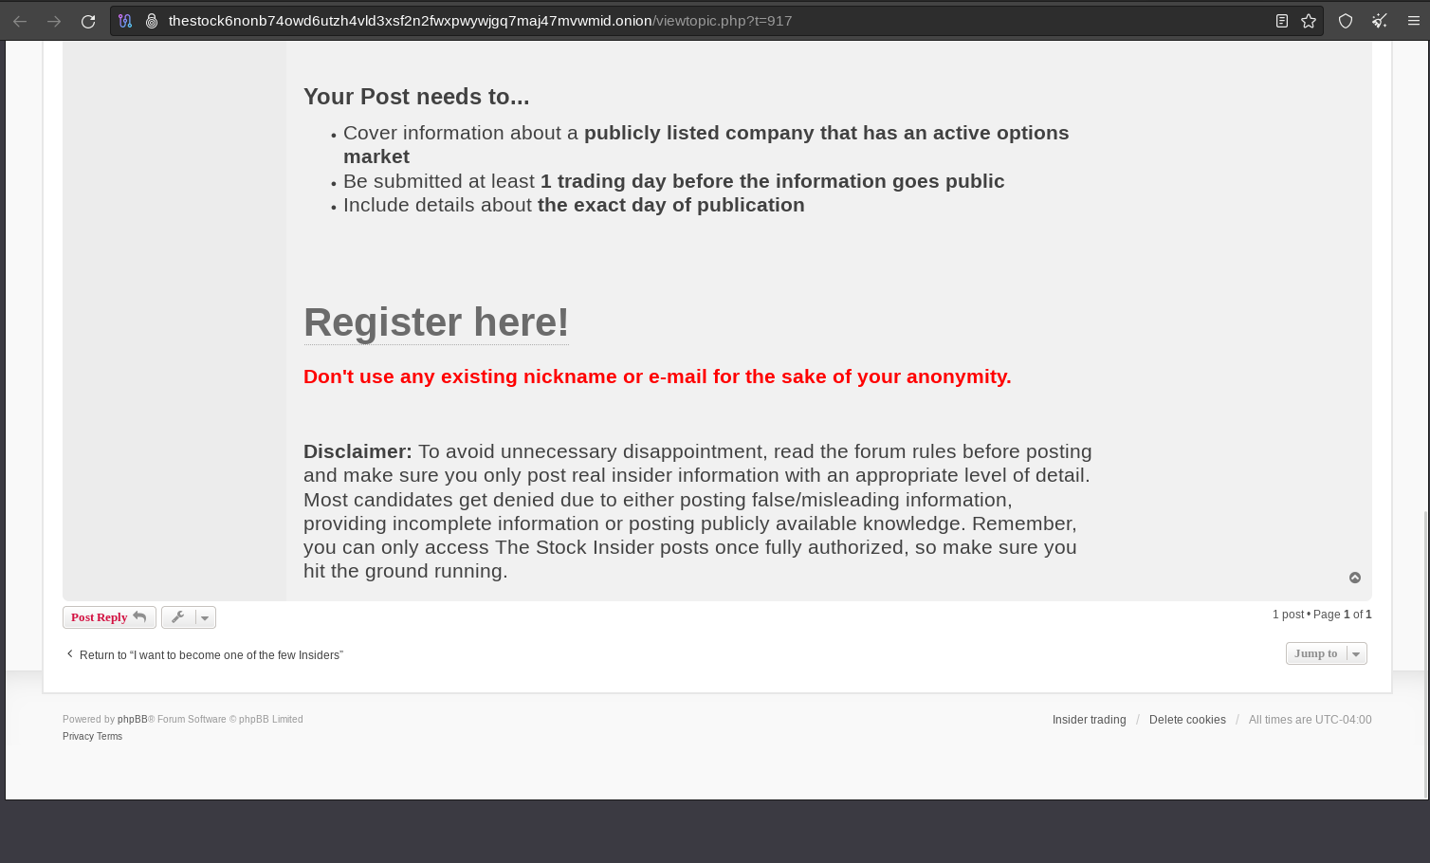

Slide 11
Operating Principles
Rules and Guidelines
Authorized members can access and share insider information securely.
Emphasis on authenticity and quality of shared information.
Strictly prohibited: false, misleading, or publicly available knowledge.
Consequences: denial or expulsion from the community.
Commitment to ethical trading practices.

Slide 12
Trading with Insider Information
Gaining an Edge
Primary objective: Profit from insider information.
Advantage of early access to crucial data about publicly listed companies with active options markets.
Making well-informed decisions before information becomes public.
Achieving profitable outcomes.
Dark Pool:
Dark pools are private trading exchanges for trading that allow institutional investors to trade large blocks of shares away from public exchanges.
Information from dark pools provides valuable insights into significant institutional buying or selling activities.
Dark pools are run by private brokerages which operate under fewer regulatory and public disclosure requirements than public exchanges.
Dark pools are estimated to account for up to 18% of U.S. and 9% of European trading volumes.
Underground Hacker Community's Edge:
Access to Dark Pool Information: The forum's insiders gain access to dark pool data, providing them with valuable insights into institutional trades before they are publicly disclosed.
Early Access to Crucial Data: By acting on dark pool information ahead of public disclosure, forum members can make informed trading decisions before the market reacts.
Enhanced Profitability: Leveraging dark pool data allows forum members to capitalize on significant price movements and profit from market inefficiencies.

Slide 13
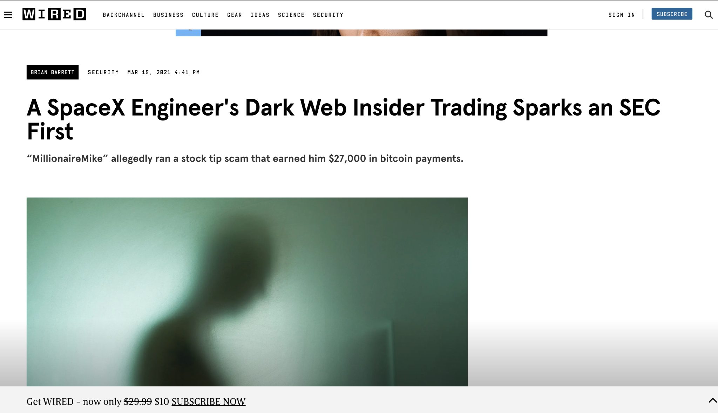

Slide 14
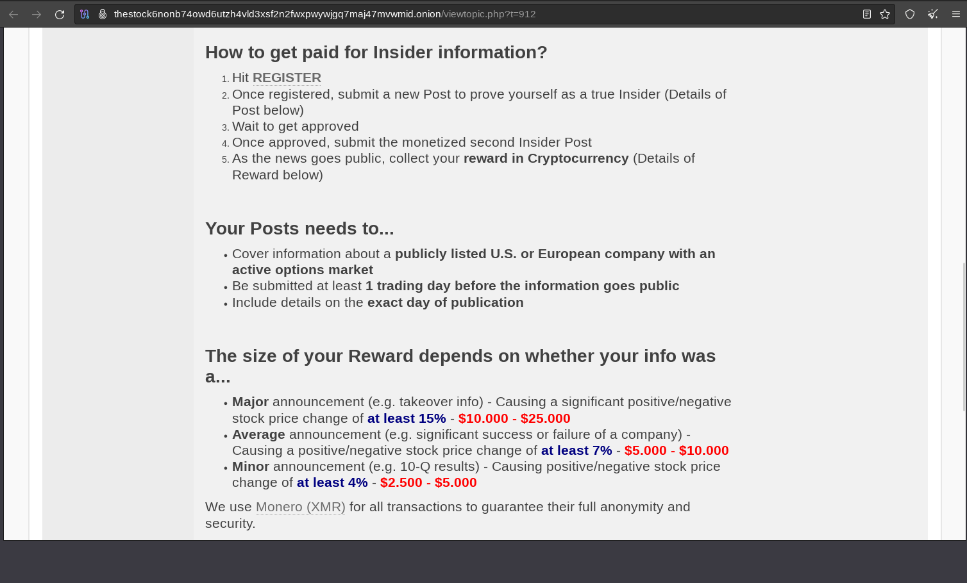

Slide 15
Trading with Insider Information (Conti…)
Ethical Considerations in the forum:
The Stock Insiders: Highly exclusive and secretive.
Selects members based on authenticity and confidentiality.
Unique approach: Sharing valuable information anonymously.
Helping members capitalize on insider knowledge and make profitable trades.
Caution: Be aware of potential legal risks associated with underground forums.
The Stock Insiders community gains a competitive edge by accessing dark pool information. (Securities and Exchange Commission (SEC) is a U.S. government oversight agency responsible for regulating the securities markets and protecting investors.)

Slide 16
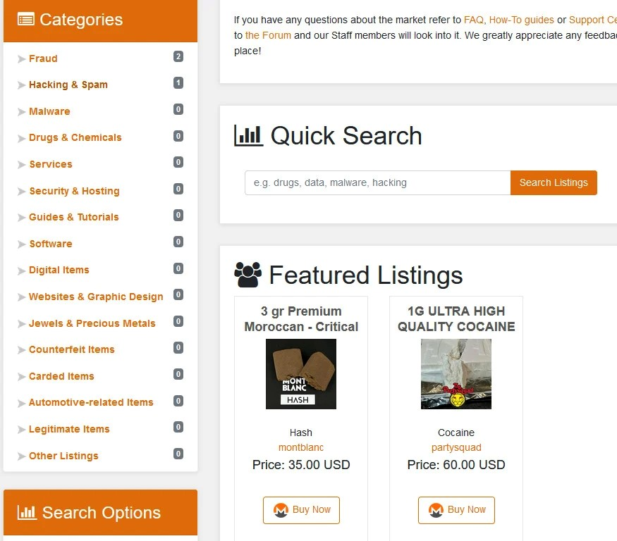
AlphaBay
AlphaBay was a darknet marketplace founded in 2014 by Alexandre Cazes, operating until its shutdown in July 2017
The marketplace had a structure similar to traditional e-commerce websites, employing administrators, moderators, public relations managers, and scamwatch personnel who received salaries from AlphaBay's revenue.
AlphaBay hosted approximately 369,000 listings in June 2017, offering illegal goods such as drugs, weapons, counterfeit items, software, and stolen credit card data.
The marketplace exclusively accepted digital currencies like Bitcoin, Monero, and Ethereum for transactions, ensuring a level of anonymity for users

Slide 17
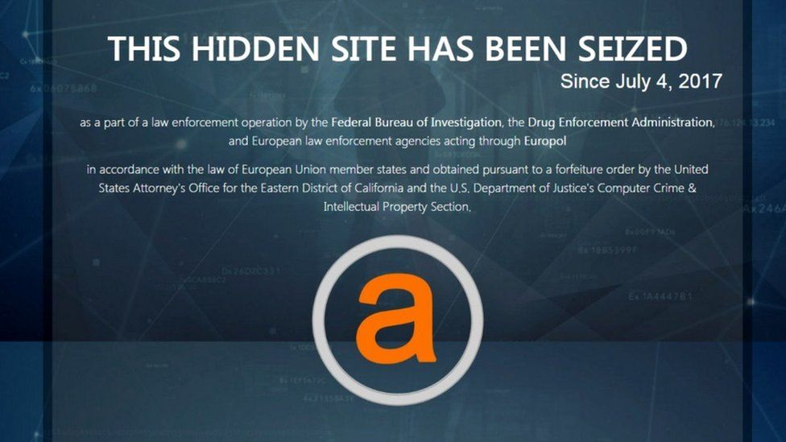
AlphaBay Shutdown
AlphaBay, a darknet marketplace founded by Alexandre Cazes in 2014, was shut down in July 2017 during Operation Bayonet, which involved law enforcement actions in the United States, Canada, and Thailand.
After its closure, AlphaBay resurfaced in August 2021, led by a co-founder known as "De-snake."
Cazes' identification was aided by his personal email found in AlphaBay's welcome email and forum password recovery process. He was arrested in Bangkok, and his laptop revealed critical information leading to asset seizure. The site's shutdown was officially announced by U.S. Attorney General Jeff Sessions on July 20, 2017.

Slide 18
HANSA Market
Hansa was a significant dark-web marketplace known for illegal transactions, focusing on drug sales and operating on the Tor network to maintain anonymity.
It became one of Europe's largest dark-web drug markets, with over 3,600 drug dealers and more than 24,000 drug product listings. It also facilitated trade in fraudulent tools and counterfeit documents.
Operation Bayonet, a 10-month investigation by the Netherlands NHTCU, identified the alleged administrators of Hansa in Germany and led to the marketplace's takeover and shutdown.
The takedown of AlphaBay in July 2017 led many of its users to migrate to Hansa Market, unknowingly falling into the hands of law enforcement, who had already taken covert control of the platform, providing valuable intelligence and aiding in disrupting the darknet trade.

Slide 19
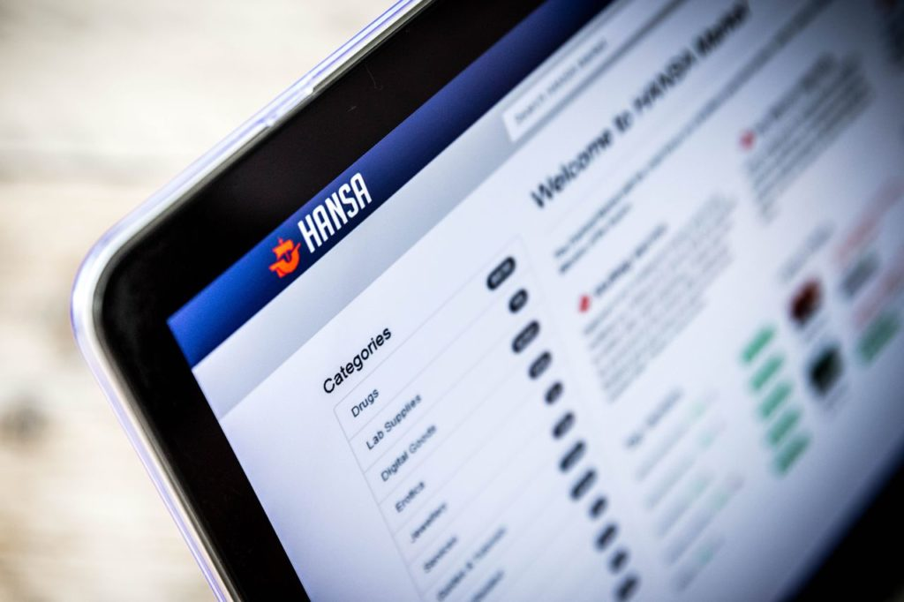
The investigation involved a strategic takeover of the platform by Dutch authorities, posing as the administrators, to gather evidence against users and dealers.
Laws invoked included drug-related offenses, computer hacking, unauthorized access, and participation in a criminal organization. If Canada was involved, their Controlled Drugs and Substances Act and Criminal Code might have applied.

Slide 20
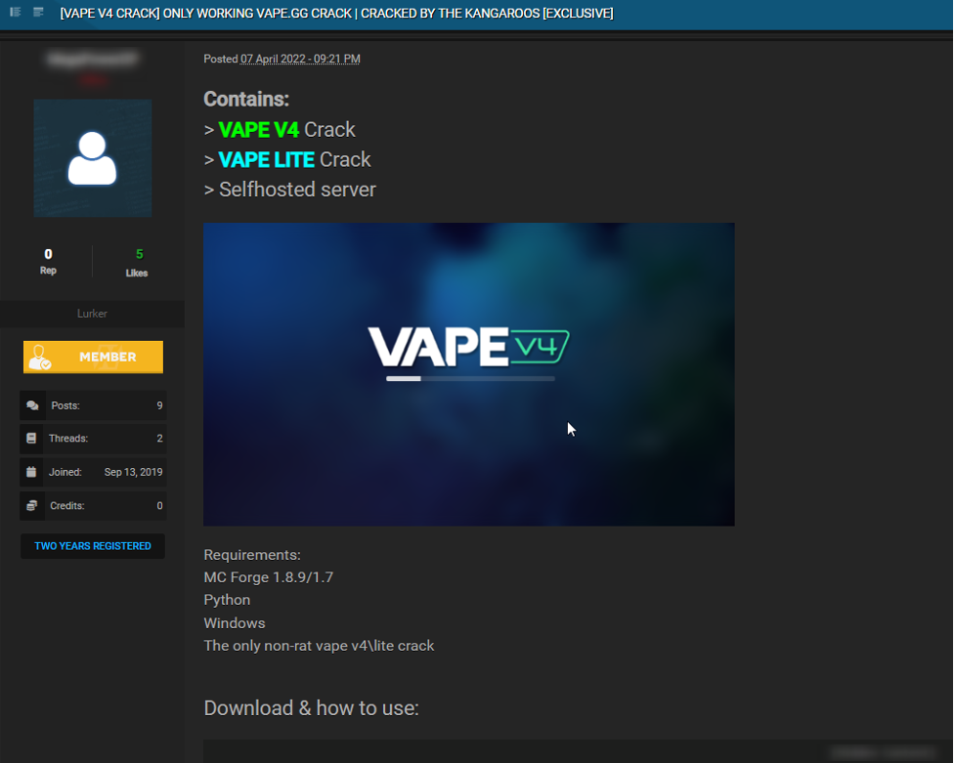
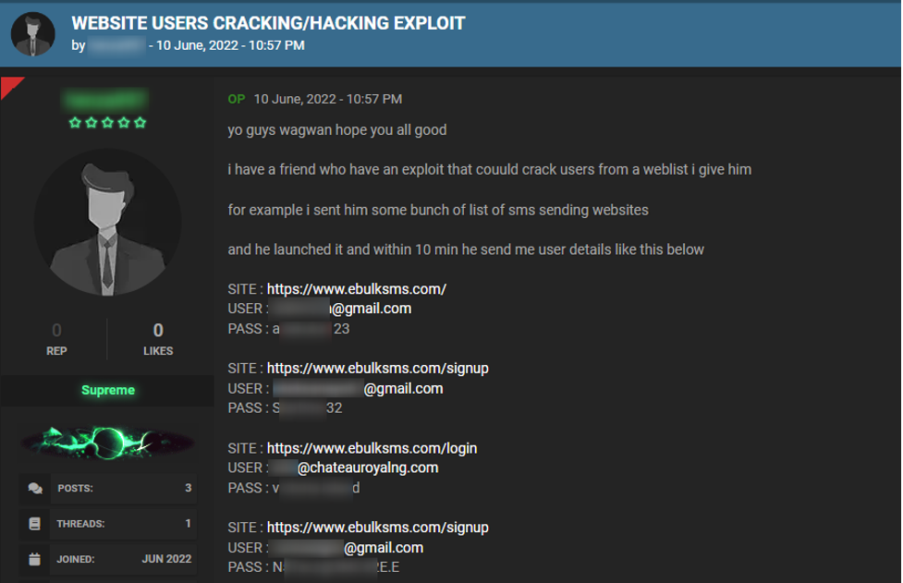
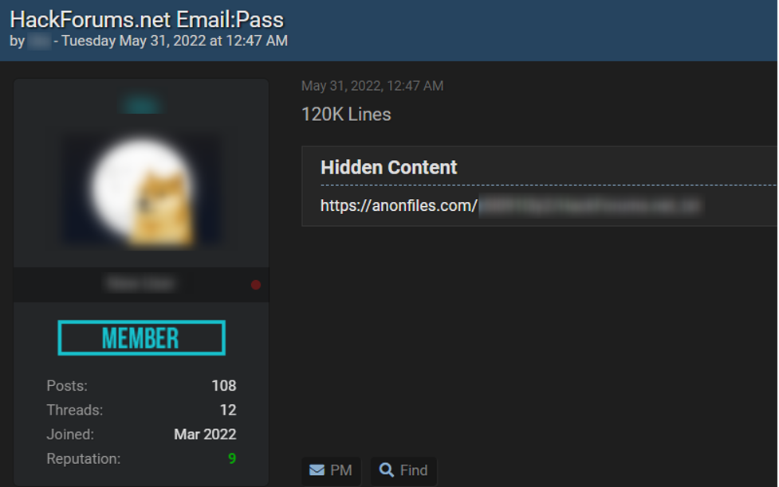
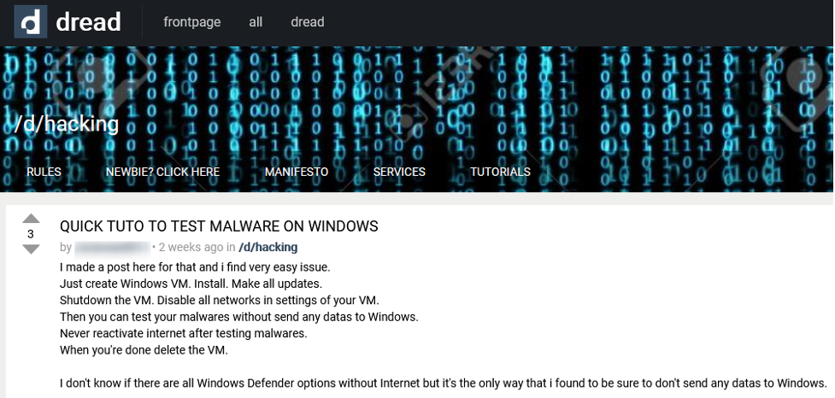
Geographical Distribution And Language Variation
China is home to the world's highest number of hackers per capita. In order to achieve domination over other nations in cyberspace, China is encouraging cybersecurity as a culture. China records a rate of 41%, United States also hold 10%, Turkey takes third place with a rate of 4.7%, Russia sits fourth with a rate of 4.3% and Taiwan with a small population of 23.78 million records 3.9%.

Slide 21
Hosting services and Internet Service Providers for Underground Forums
ISP: Black.Host, CyberBunker, McColo, Flokinet etc
Bulletproof Hosting Services
Offshore Hosting Providers
Virtual Private Server (VPS)
ISPs taken down by law enforcement
CyberBunker, taken down in September 2019.
McColo, taken down in November 2008.
Russian Business Network (RBN), taken down in November 2007.
Atrivo, taken down in September 2008.
3FN, taken down by FTC in June 2009.
Proxiez, taken down in May 2010

Slide 22
How Bulletproof Hosting works
1. They permit users to run websites that engage in phishing, frauds (including high-yield investment schemes), botnet masters, and illegal internet pharmacies.
2. The BPH providers—also referred to as "offshore providers"—operate in nations without extradition or MLAT agreements with the five eye countries, primarily the United States.
BPH hosting countries (Data Centers)
Russia (being more liberal), Ukraine, China, Moldova, Romania, Bulgaria, Belize, Panama, and the Seychelles.

Slide 23
Significance of hosting services cooperation in tackling cybercrime effectively
Information sharing
Timely response
Global reach
Public-private partnership

Slide 24
Challenges Faced by Law Enforcement and Cybersecurity Professionals
Anonymity and Encryption
Cross-Jurisdictional Issues
Fast Evolution and Resilience
Private Communication Channels
Emergence of Dark Marketplaces
Notes:
Anonymity and Encryption: Forums' use of strong encryption and Tor hinders identifying individuals or operations.
Cross-Jurisdictional Issues: Cybercrimes transcend borders, complicating coordination among law enforcement agencies.
Fast Evolution and Resilience: Forums adapt swiftly, evading takedowns, making disruption challenging.
Private Communication Channels: Encrypted messaging conceals transactions and planning, eluding surveillance.
Scalability of Forums: Rapid growth demands prioritization of targets amidst high user volumes.
Emergence of Dark Marketplaces: Forums create multifaceted dark marketplaces, challenging law enforcement efforts.

Slide 25
Strategies for Mitigation
International Collaboration
Cyber Threat Intelligence Sharing
Infiltration and Undercover Operations
Disruption of Cryptocurrency Transactions
Targeted Legal Actions
Public Awareness and Education
Technological Solutions
Regulation of Hosting Providers
Adaptive Approaches
Notes:
International Collaboration:Establish partnerships between international law enforcement, cybersecurity firms, and governments.
Cyber Threat Intelligence Sharing:Encourage public-private threat intel sharing for proactive strategies.
Infiltration and Undercover Operations:Deploy operatives for undercover infiltration, evidence gathering, including targeted spear phishing.
Disruption of Cryptocurrency Transactions:Collaborate with crypto exchanges, block illicit transactions, disrupt financial support.
Targeted Legal Actions:Initiate legal action against administrators, moderators, to deter and disrupt.
Public Awareness and Education:Educate about risks of engaging with forums, reducing appeal.
Technological Solutions:Develop advanced tools to monitor and neutralize cybercriminal activities.
Regulation of Hosting Providers:Collaborate with hosts for server takedowns, impede operations.
Adaptive Approaches:Evolve strategies to match dynamic forum tactics, maintain effectiveness.

Slide 26


Slide 27
Q/A

